Slide 1





Register/Login Management using OpenCV

Slide 2
Table of content :
What is Register/Login Management
Introduction
Interface
Working module
End user

Slide 3
What is Register and Login Management using Open CV?

Slide 4
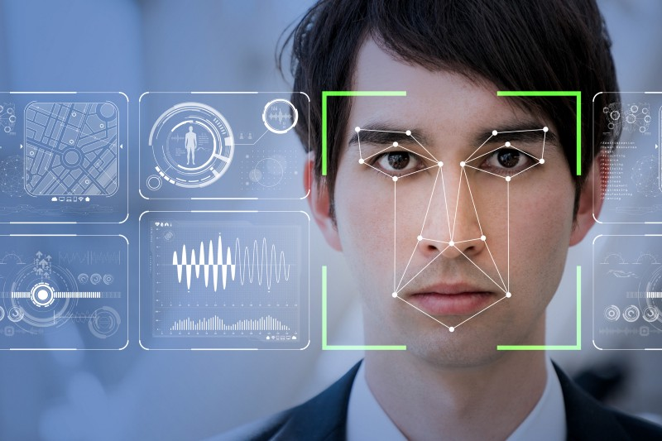
Register and Login Management using OpenCV is basically a idea of login interface using image of respective person.
Registering an username with an image which will be stored in the database and while login the login interface checks the image of respective username-holder and the image stored with the username.
Then allows the user to login if the image verification fails Image verification failed will be displayed on the login interface.

Slide 5
INTRODUCTION

Slide 6
As the name suggests, “Register/Login Management using OpenCV” is centered around Register and Login management.
The goal of this article is to provide an easier human-machine interaction routine when user authentication is needed through face detection and recognition.
The user enters username and password but our project uses OpenCV – Face Detection, which quantifies the face into an array of 128 numbers.
The face is scanned when registered and compared during logging in.
After logging in , the user can create , edit and delete files.

Slide 7
In the source-code we used imported different kinds of modules like
tkinter,SQLite3,cv2,numpy,face_recognition etc.
Tkinter - Graphical User Interface(GUI).
SQLite3 – Developed data base.
Cv2 – Display an image in a window.
NumPy – Working with arrays.
face recognition – Detect faces in an image.

Slide 8
INTERFACE

Slide 9

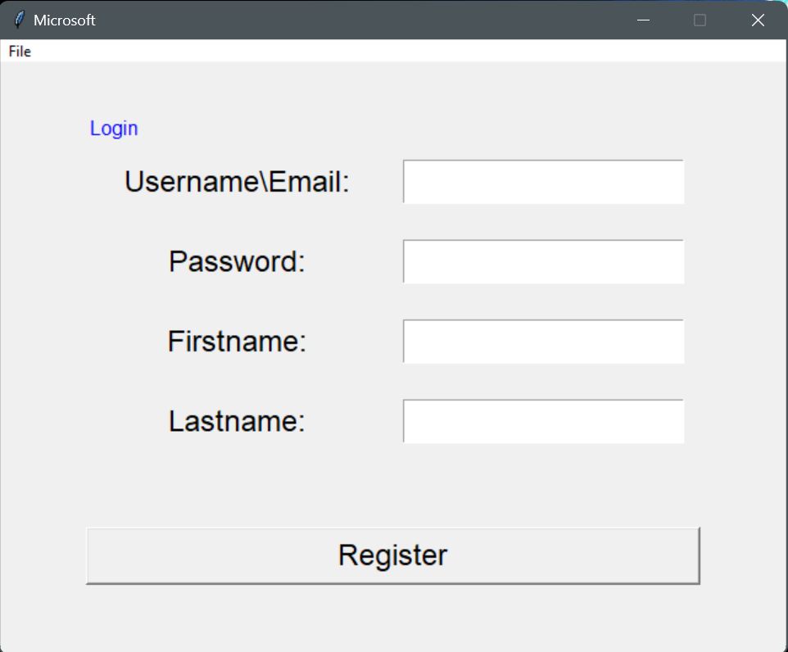
Registration Interface

Slide 10
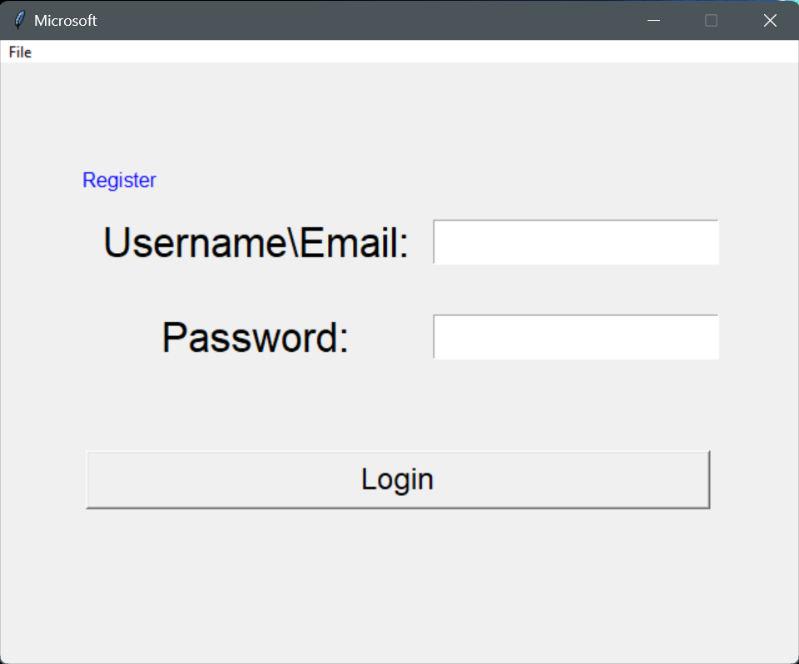
Login Interface

Slide 11
WORKING MODULE

Slide 12
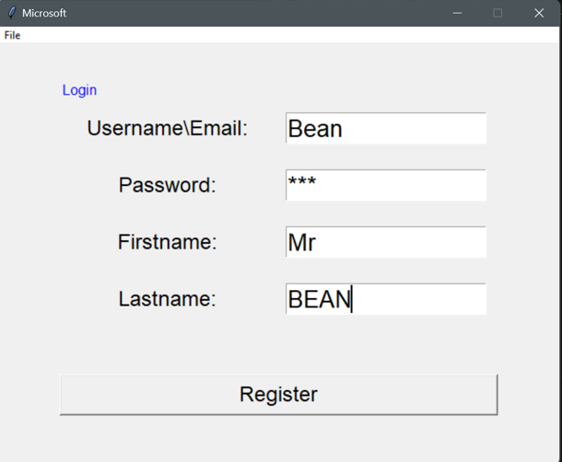
Register using
Username
Password
First name
Last name
Click on Register

Slide 13
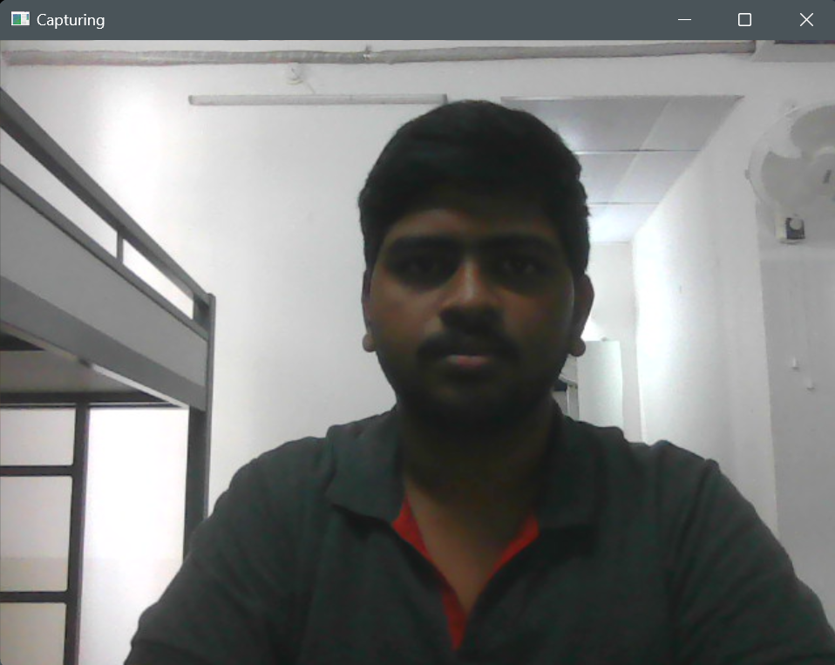


Press s to capture and save the image

Slide 14
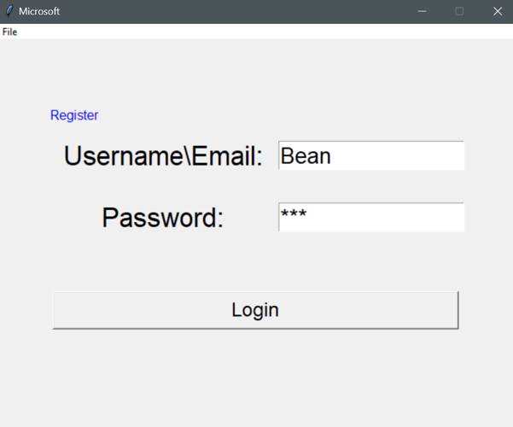
Login Interface
Enter login details
Click on Login

Slide 15
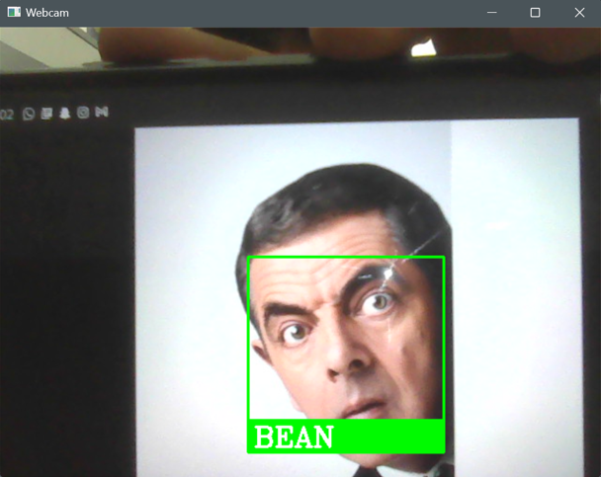
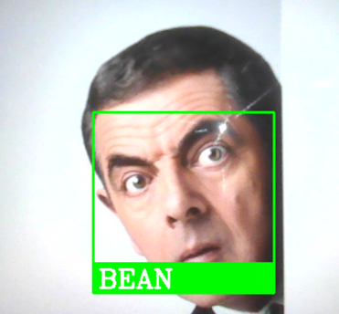
Image Verification
Press ENTER

Slide 16
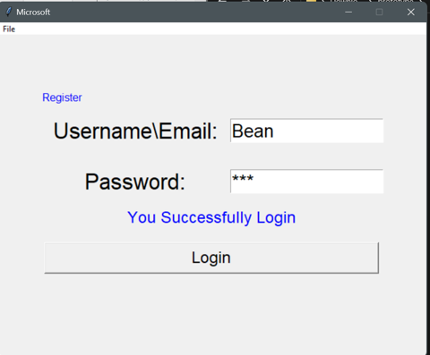
If images matches
Login successful

Slide 17
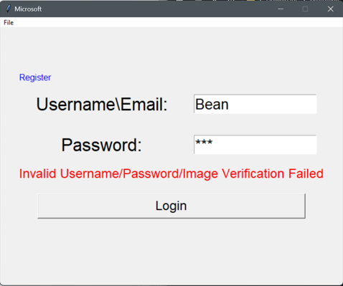
If images not matched
Image Verification Failed!!

Slide 18
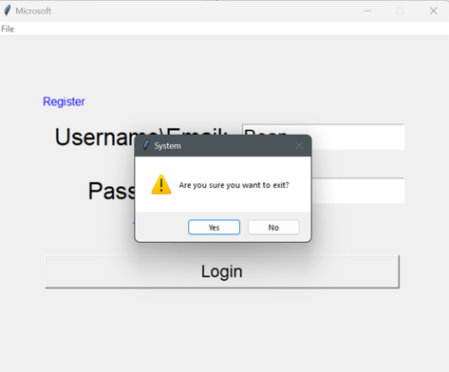
Click on file and then Press Exit to Quit

Slide 19
Roadmap
Run the code
Login with username entered at the time of registration
Face Verifiaction
With image
1
3
5
2
4
6
Register with username and image
Check the image and username and press Enter
Login Successful

Slide 20
END USER

Slide 21
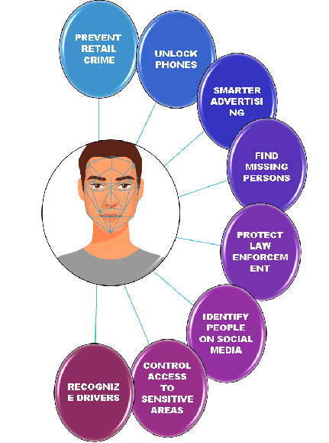
Where we can use this?
Face recognition is used widely across the world for security .
Logging in through ones face can add more security to the personal files or accounts.
This can be used in any login based portals or files or accounts which helps the user to secure their things.

Slide 22


Thanks!

Slide 23
Team Presentation by :
PAVAN SASTRY NVSS - AP21110010209
ABHIRAM SANNIDHI - AP21110010216
SRINIVAS PRADHAN - AP21110010220
KRISHNA SRAVANTH - AP21110010254

